Slide 1
ECEG-5193: Algorithm Analysis and Design
Analysis of Sorting and Searching algorithms
Red Black Trees

Slide 2
Red-Black Trees
Binary search tree with an additional attribute for its nodes: color which can be red or black
Constrains the way nodes can be colored on any path from the root to a leaf.
Balanced tree → O(logN)

Slide 3
Example: RED-BLACK-TREE
26
17
41
NIL
NIL
30
47
38
NIL
50
NIL
NIL
NIL
NIL
NIL
For convenience, we add NIL nodes and refer to them as the leaves of the tree.
Color[NIL] = BLACK

Slide 4
Red-Black-Trees Properties
(**Binary search tree property is satisfied**)
Every node is either red or black
The root is black
Every leaf (NIL) is black
If a node is red, then both its children are black
No two consecutive red nodes on a simple path
from the root to a leaf
For each node, all paths from that node to a leaf contain the same number of black nodes

Slide 5
Definitions
h = 4
bh = 2
26
h = 1
bh = 1
h = 3
bh = 2
17
41
NIL
NIL
h = 2
bh = 1
h = 2
bh = 1
30
47
h = 1
bh = 1
38
50
h = 1
bh = 1
NIL
NIL
NIL
NIL
NIL
NIL
Height of a node: the number of edges in the longest path to a leaf.
Black-height bh(x) of a node x: the number of black nodes (including NIL) on the path from x to a leaf, not counting x.

Slide 6
Height of Red-Black-Trees
A red-black tree with n internal nodes
has height at most 2log(N+1)
Need to prove two claims first …

Slide 7
Claim 1
Any node x with height h(x) has bh(x) ≥ h(x)/2
Proof
By property 4, at most h/2 red nodes on the path from the node to a leaf
Hence at least h/2 are black
h = 4
bh = 2
26
h = 1
bh = 1
h = 3
bh = 2
17
41
NIL
NIL
h = 2
bh = 1
h = 2
bh = 1
30
47
h = 1
bh = 1
38
50
h = 1
bh = 1
NIL
NIL
NIL
NIL
NIL
NIL

Slide 8
Claim 2
The subtree rooted at any node x contains at least 2^{bh(x)} - 1 internal nodes
h = 4
bh = 2
26
h = 1
bh = 1
h = 3
bh = 2
17
41
NIL
NIL
h = 2
bh = 1
h = 2
bh = 1
30
47
h = 1
bh = 1
38
50
h = 1
bh = 1
NIL
NIL
NIL
NIL
NIL
NIL

Slide 9
Claim 2 (cont’d)
Proof: By induction on h[x]
Basis: h[x] = 0 ⇒
x is a leaf (NIL[T]) ⇒
bh(x) = 0 ⇒
# of internal nodes: 2⁰ - 1 = 0
Inductive Hypothesis: assume it is true for h[x]=h-1
x
NIL

Slide 10
Claim 2 (cont’d)
Inductive step:
Prove it for h[x]=h
internal nodes at x=
internal nodes at l +
internal nodes at r + 1
Using inductive hypothesis:
internal nodes at x ≥ (2^{bh(l)} – 1) + (2^{bh(r)} – 1) + 1
x
h
l
r
h-1

Slide 11
Claim 2 (cont’d)
Let bh(x) = b, then any child y of x has:
bh (y) =
bh (y) =
b (if the child is red), or
bh(y)≥bh(x)-1
b - 1 (if the child is black)
bh = 2
x
bh = 1
26
y₁
y₂
bh = 2
17
41
NIL
NIL
30
47
NIL
38
NIL
50
NIL
NIL

Slide 12
Claim 2 (cont’d)
So, back to our proof:
internal nodes at x ≥ (2^{bh(l)} – 1) + (2^{bh(r)} – 1) + 1
≥ (2^{bh(x) - 1} – 1) + (2^{bh(x) - 1} – 1) + 1 =
2 · (2^{bh(x) - 1} - 1) + 1 =
2^{bh(x)} - 1 internal nodes
x
h
l
r
h-1

Slide 13
Height of Red-Black-Trees (cont’d)
A red-black tree with N internal nodes has height at most 2log(N+1).
Proof:
N
Solve for h:
N + 1 ≥ 2^{h/2}
log(N + 1) ≥ h/2 ⇒
h ≤ 2 log(N + 1)
bh(root) = b
height(root) = h
root
≥ 2^{b} - 1
≥ 2^{h/2} - 1
number
of internal
nodes
l
r
Claim 2
Claim 1

Slide 14
Operations on Red-Black-Trees
Non-modifying binary-search-tree operations (e.g., RetrieveItem, GetNextItem, ResetTree), run in O(h)=O(logN) time
What about InsertItem and DeleteItem?
They will still run on O(logN)
Need to guarantee that the modified tree will still be a valid red-black tree

Slide 15
InsertItem
What color to make the new node?
Red? Let’s insert 35!
Property 4 is violated: if a node is red, then both its children are black
Black? Let’s insert 14!
Property 5 is violated: all paths from a node to its leaves contain the same number of black nodes
26
17
41
30
47
38
50

Slide 16
DeleteItem
26
17
41
What color was the
node that was removed? Black?
Every node is either red or black
The root is black
Every leaf (NIL) is black
If a node is red, then both its children are black
For each node, all paths from the node to descendant leaves contain the same number of black nodes
30
47
38
50
OK!
Not OK! If removing the root and the child that replaces it is red
OK!
Not OK! Could change the
black heights of some nodes
Not OK! Could create
two red nodes in a row

Slide 17
Rotations
Operations for re-structuring the tree after insert and delete operations
Together with some node re-coloring, they help restore the red-black-tree property
Change some of the pointer structure
Preserve the binary-search tree property
Two types of rotations:
Left & right rotations

Slide 18
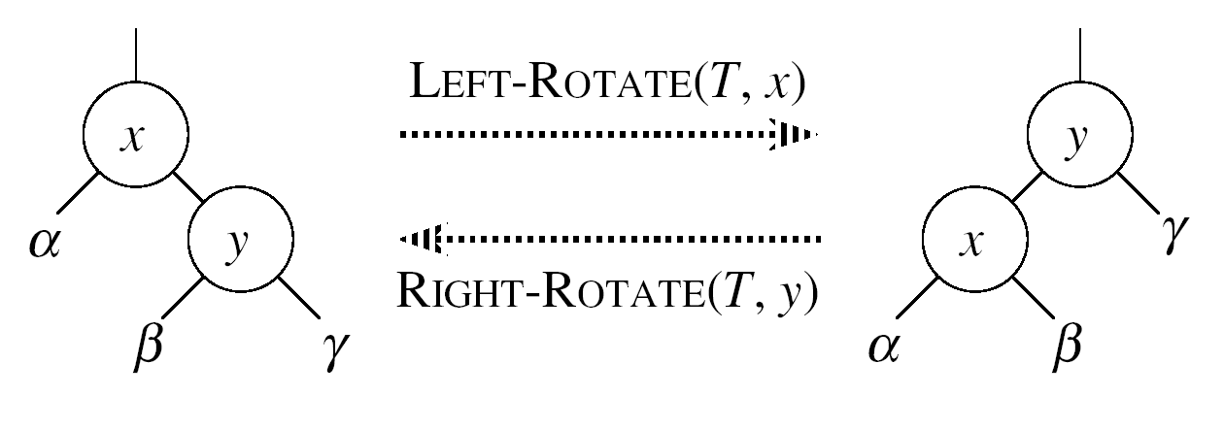
Left Rotations
Assumptions for a left rotation on a node x:
The right child y of x is not NIL
Idea:
Pivots around the link from x to y
Makes y the new root of the subtree
x becomes y’s left child
y’s left child becomes x’s right child

Slide 19
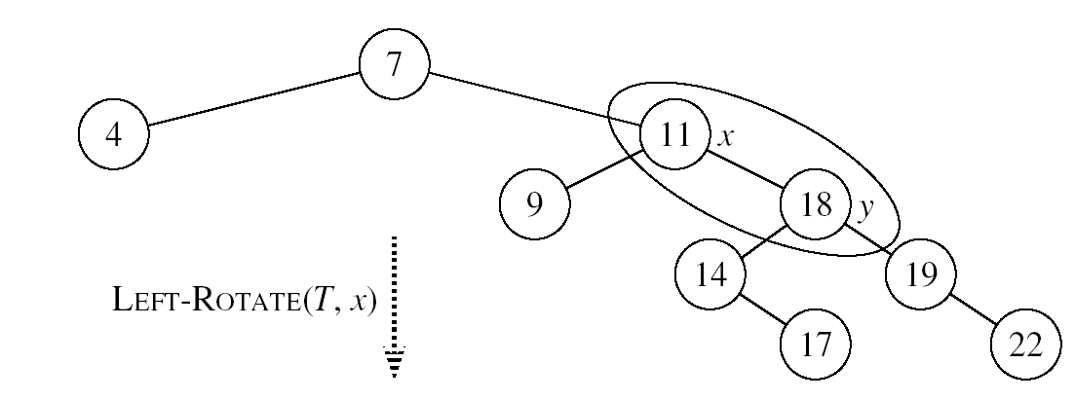
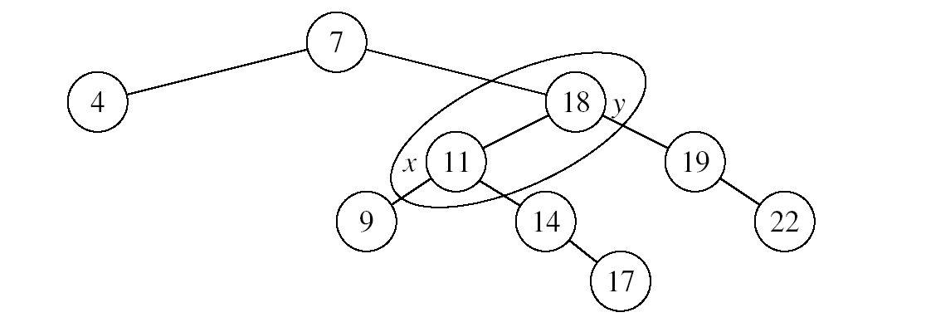
Example: LEFT-ROTATE

Slide 20
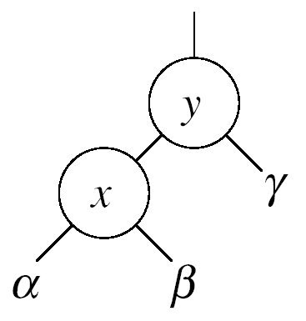
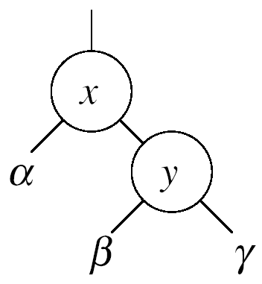


Right Rotations
Assumptions for a right rotation on a node x:
The left child x of y is not NIL
Idea:
Pivots around the link from y to x
Makes x the new root of the subtree
y becomes x’s right child
x’s right child becomes y’s left child

Slide 21
InsertItem
Goal:
Insert a new node z into a red-black tree
Idea:
Insert node z into the tree as for an ordinary binary search tree
Color the node red
Restore the red-black tree properties
i.e., use RB-INSERT-FIXUP

Slide 22
RB Properties Affected by Insert
OK!
Every node is either red or black
The root is black
Every leaf (NIL) is black
If a node is red, then both its children are black
For each node, all paths
from the node to descendant
leaves contain the same number
of black nodes
If z is the root
⇒ not OK
OK!
If p(z) is red ⇒ not OK
z and p(z) are both red
OK!
26
17
41
38
47
50

Slide 23
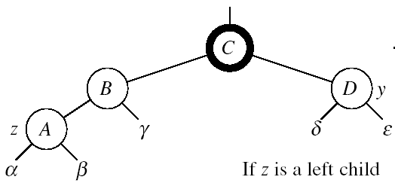
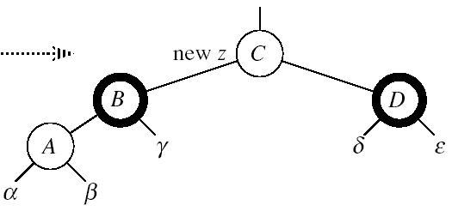

RB-INSERT-FIXUP
Case 1: z’s “uncle” (y) is red
(z could be either left or right child)
Idea:
p[p[z]] (z’s grandparent) must be black.
color p[z] ← black
color y ← black
color p[p[z]] ← red
z = p[p[z]]
Push the “red” violation up the tree

Slide 24
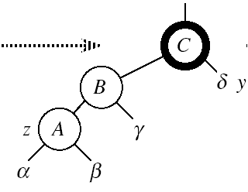

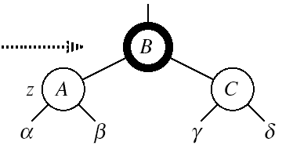
RB-INSERT-FIXUP
Case 2:
z’s “uncle” (y) is black
z is a left child
Idea:
color p[z] ← black
color p[p[z]] ← red
RIGHT-ROTATE(T, p[p[z]])
No longer have 2 reds in a row
p[z] is now black
Case 2

Slide 25
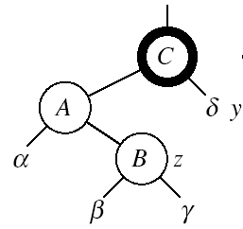
RB-INSERT-FIXUP
Case 3:
z’s “uncle” (y) is black
z is a right child
Idea:
z ← p[z]
LEFT-ROTATE(T, z)
⇒ now z is a left child, and both z and p[z] are red ⇒ case 2
Case 3
Case 2

Slide 26
Example
Insert 4
11
Case 1
11
Case 3
2
14
2
14
y
1
7
7
z
15
1
15
5
8
y
5
8
z and p[z] are both red
z’s uncle y is red
z and p[z] are both red
z’s uncle y is black
z is a right child
z
4
4
11
7
Case 2
z
7
14
y
2
11
z
2
8
15
1
5
8
14
1
5
z and p[z] are red
z’s uncle y is black
z is a left child
4
15
4

Slide 27
RB-INSERT-FIXUP(T, z)
while color[p[z]] = RED
do if p[z] = left[p[p[z]]]
then y ← right[p[p[z]]]
if color[y] = RED
then Case1
else if z = right[p[z]]
then Case2
Case3
else (same as then clause with “right” and “left” exchanged)
color[root[T]] ← BLACK
The while loop repeats only when
case1 is executed: O(logN) times
Set the value of x’s “uncle”
We just inserted the root, or
The red violation reached the root

Slide 28
Analysis of InsertItem
Inserting the new element into the tree O(logN)
RB-INSERT-FIXUP
The while loop repeats only if CASE 1 is executed
The number of times the while loop can be executed is O(logN)
Total running time of InsertItem: O(logN)

Slide 29
DeleteItem
Delete as usually, then re-color/rotate
A bit more complicated though …

Slide 30
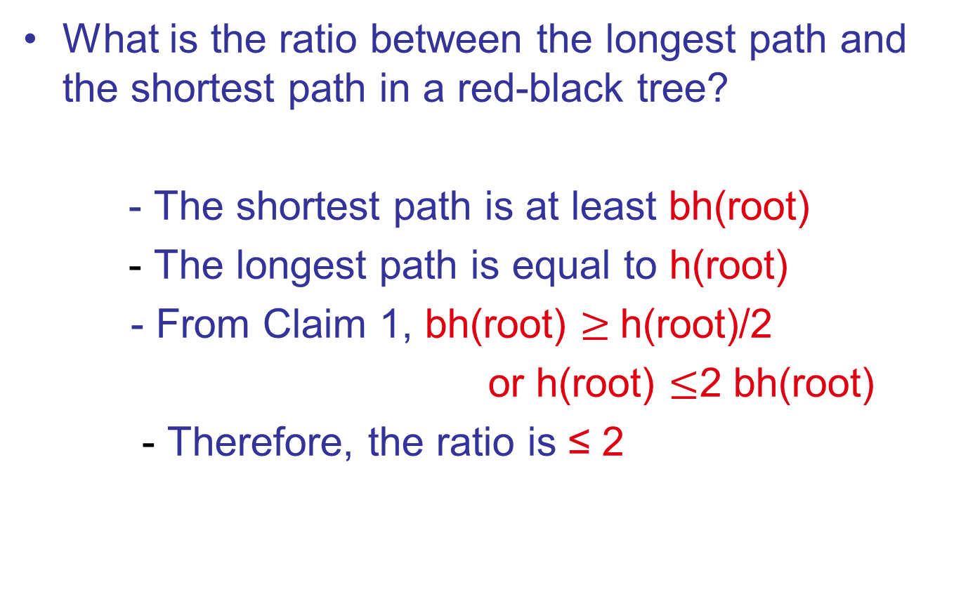
Problems

Slide 31
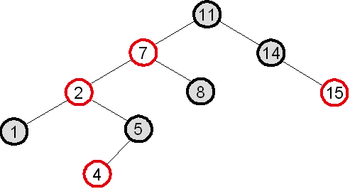
Problems
What red-black tree property is violated in the tree below? How would you restore the red-black tree property in this case?
Property violated: if a node is red, both its children are black
Fixup: color 7 black, 11 red, then right-rotate around 11
7
z
2
11
1
5
8
14
4
15

Slide 32
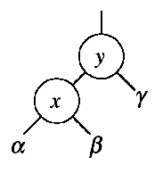
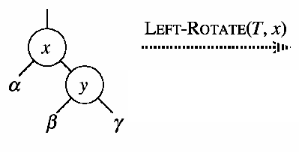
Problems
Let a, b, c be arbitrary nodes in subtrees α, β, γ in the tree below. How do the depths of a, b, c change when a left rotation is performed on node x?
a: increases by 1
b: stays the same
c: decreases by 1

Slide 33
Problems
When we insert a node into a red-black tree, we initially set the color of the new node to red. Why didn’t we choose to set the color to black?
Would inserting a new node to a red-black tree and then immediately deleting it, change the tree?

Slide 34
Red Black Trees
Top-Down Insertion

Slide 35
Review of Bottom-Up Insertion
In B-Up insertion, “ordinary” BST insertion was used, followed by correction of the tree on the way back up to the root
This is most easily done recursively
Insert winds up the recursion on the way down the tree to the insertion point
Fixing the tree occurs as the recursion unwinds

Slide 36
Top-Down Insertion Strategy
In T-Down insertion, the corrections are done while traversing down the tree to the insertion point.
When the actual insertion is done, no further corrections are needed, so no need to traverse back up the tree.
So, T-Down insertion can be done iteratively which is generally faster

Slide 37
Goal of T-D Insertion
Insertion is always done as a leaf (as in ordinary BST insertion)
Recall from the B-Up flow chart that if the uncle of a newly inserted node is black, we restore the RB tree properties by one or two local rotations and recoloring – we do not need to make changes further up the tree

Slide 38
Goal (2)
Therefore, the goal of T-D insertion is to traverse from the root to the insertion point in such a way that RB properties are maintained, and at the insertion point, the uncle is Black.
That way we may have to rotate and recolor, but not propagate back up the tree

Slide 39
Possible insertion configurations
X (Red or Black)
Y
Z
If a new node is inserted as a child of Y or Z, there is no problem since the new node’s parent is black

Slide 40
Possible insertion configurations
X
Y
Z
If new node is child of Z, no problem since Z is black.
If new node is child of Y, no problem since the new node’s uncle (Z) is black – do a few rotations and recolor…. done

Slide 41
Possible insertion configurations
X
Y
Z
If new node is inserted as child of Y or Z, it’s uncle will be red and we will have to go back up the tree. This is the only case we need to avoid.

Slide 42
Top-Down Traversal
As we traverse down the tree and encounter this case, we recolor and possible do some rotations.
There are 3 cases.
X
Y
Z
Remember the goal – to create an insertion point at which the parent of the new node is Black, or the uncle of the new node is black.

Slide 43
Case 1 – X’s Parent is Black
P
P
X
X
Y
Z
Y
Z
Just recolor and continue down the tree

Slide 44
Case 2
X’s Parent is Red (so Grandparent is Black) and X and P are both left/right children
Rotate P around G
Color P black
Color G red
Note that X’s uncle, U, must be black because it (a) was initially black, or (b) would have been made black when we encountered G (which would have had two red children -- X’s Parent and X’s uncle)

Slide 45
Case 2 diagrams
G
P
P
U
G
X
X
S
Z
Y
Z
Y
S
U
Rotate P around G. Recolor X, Y, Z, P and G

Slide 46
Case 3
X’s Parent is Red (so Grandparent is Black) and X and P are opposite children
Rotate P around G
Color P black
Color G red
Again note that X’s uncle, U, must be black because it (a) was initially black, or (b) would have been made black when we encountered G (which would have had two red children -- X’s Parent and X’s uncle)

Slide 47
Case 3 Diagrams (1 of 2)
G
G
X
P
U
U
P
Z
S
X
S
Y
Y
Z
Step 1 – recolor X, Y and Z. Rotate X around P.

Slide 48
Case 3 Diagrams (2 of 2)
X
G
X
U
P
G
P
Z
S
Y
Z
U
S
Y
Step 2 – Rotate X around G. Recolor X and G

Slide 49
An exercise – insert F
D
T
L
W
J
P
V
Z
E
K

Slide 50
Top-Down Insert Summary
Case 1
P is Black
Just Recolor
Recolor X,Y,Z
P
P
X
X
Y
Z
Y
Z
Case 2 P is Red X & P both left/right
G
G
Rotate P around G Recolor P,G
P
Recolor X,Y,Z
G
P
P
X
Y
Z
X
X
Y
Z
Y
Z
Case 3 P is Red X and P are opposite children
G
G
X
Recolor X,Y,Z Rotate X around P
Rotate X around G Recolor X, G
G
P
X
P
P
X
Y
Z
Y
Z
Y
Z

